Slide 1
STAT 824
Final Project
Kushal Shah
Car Sales Analysis For Sales Maximization

Slide 2
Overview
Purpose: Analyse car sales data for actionable insights.
Background:
Data Source: Car_sales.csv file
Why this data matters:
It captures industry critical metrics for short term profit maximization.
Useful for understanding manufacturer performance and market demand.

Slide 3
Literature Review
“Price Dispersion is an important indicator of pricing strategy and market efficiency. The findings show that price dispersion has positively impacted sales.” [1]
“Fuel efficiency is a critical driver of sales, especially in environmentally conscious markets.” [2]
“The higher the sales, the higher the company’s performance and profitability, so it’s very critical for sustainability.”[3]

Slide 4

Design and Data Collection
Design Process:
Shiny dashboard to visualize data and insights interactively.
Data Collection:
Variables: Sales, Price, Efficiency, Curb weight
Preprocessing: Handled missing values, added PCA components for multidimensionality reducation, and categorized fuel efficiency.
Large Scale dataset with sales from multiple manufacturers.

Slide 5
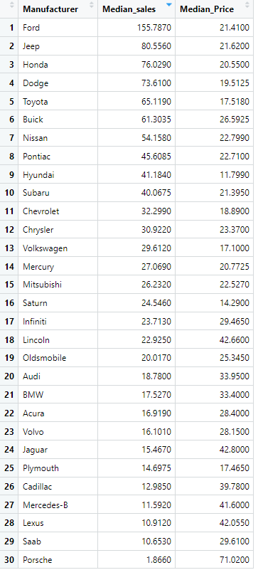
Data Analysis
Statistical computations were done in Median approach instead of mean to avoid outlier extremes that would shift the results otherwise.

Slide 6
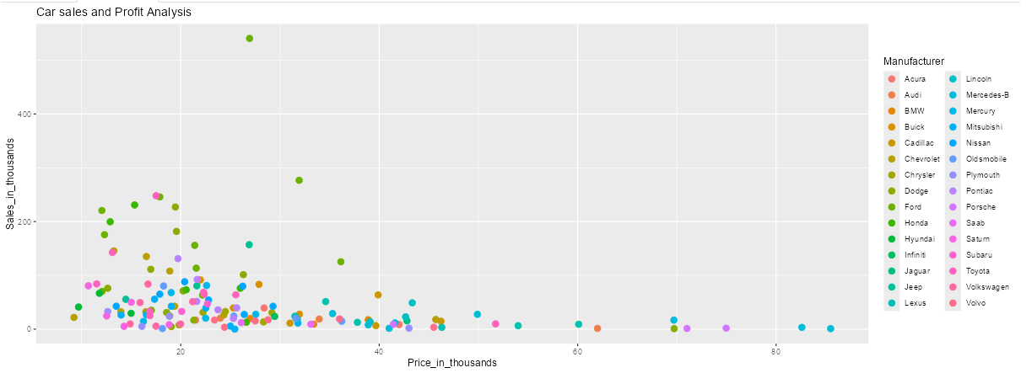
Median sales vs price for each manufacturer
Customers appear to be price sensitive and thus the peak of sales happens for the lower set of car prices

Slide 7
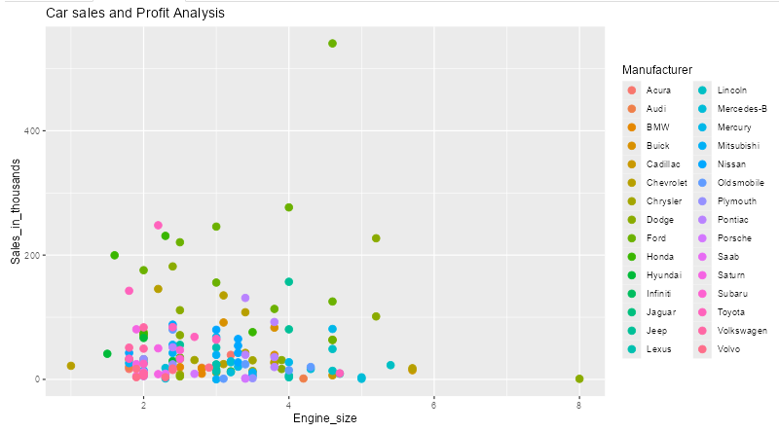
Energy Size vs Sales

Slide 8
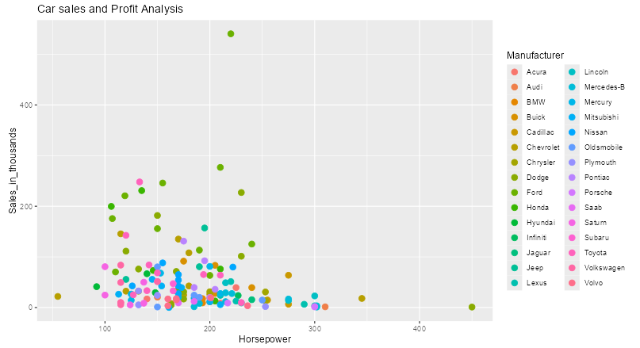
Horsepower vs Sales

Slide 9
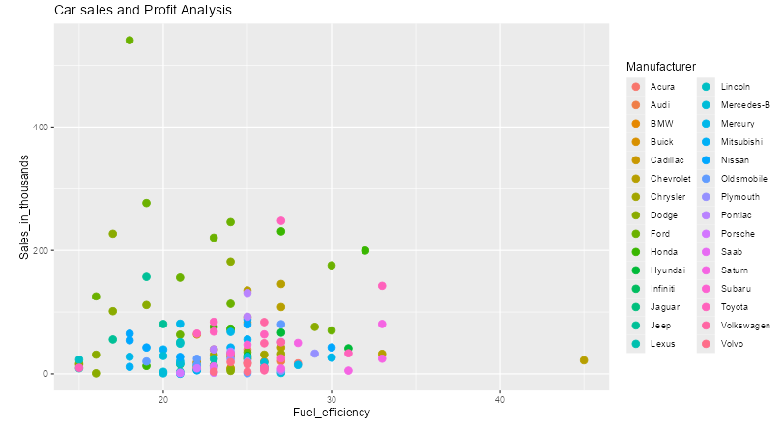
Fuel Efficiency vs Sales
High efficiency cars dominate sales in certain segments.
Medium efficiency cars balance affordability and performance.

Slide 10
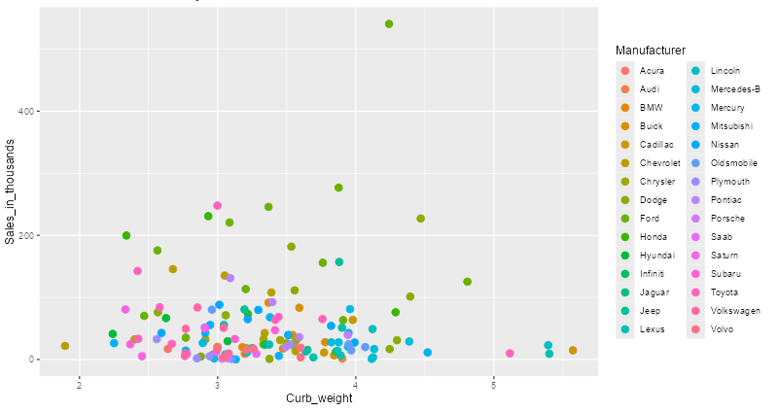
Curb Weight vs Sales

Slide 11
Actionable Insights For Short-Term Sales Maximization
Focus on High-Sales Segments:
Medium and high efficiency vehicles with balanced performance.
Optimize Pricing:
Reduce the pricing for vehicle, to witness a trend of high period sales
Target High-performing manufacturers:
Allocate resources to brands with consistent sales performance.
Adapt Clustering:
Adapt production based on PCA-identified clusters.

Slide 12
Github
All projects details and files have been uploaded below for user iteraction and deeper insights
https://github.com/kshah725/car-sales-shiny-app/tree/main

Slide 13
References
https://www.researchgate.net/publication/363097869_The_Effects_of_Price_Dispersion_on_Sales_in_the_Automobile_Industry_A_Dynamic_Panel_Analysis
https://www.researchgate.net/publication/291757350_Fuel_efficiency_and_the_economy
https://www.ijmsssr.org/paper/IJMSSSR001037.pdf

